Slide 1
ANALYSIS ON THE NUMBER OF PENDING CASES IN THE VARIOUS COURTS OF THE STATES OF INDIA
INTRODUCTION TO DATA SCIENCE PROJECT
UE17CS203

Slide 2
ABSTRACT
The dataset consists of the number of pending cases per judge per court for a given year corresponding to varying periods of time for each state of India. The dataset has been taken from www.kaggle.com .
The dataset has been cleaned by removing the NULL values.
We have chosen Karnataka for descriptive as well as statistical analysis of the dataset. The upcoming slides show the box plot, normal plot, bar graph, and pie chart illustrations of the various courts of Karnataka and their respective pending cases.

Slide 3
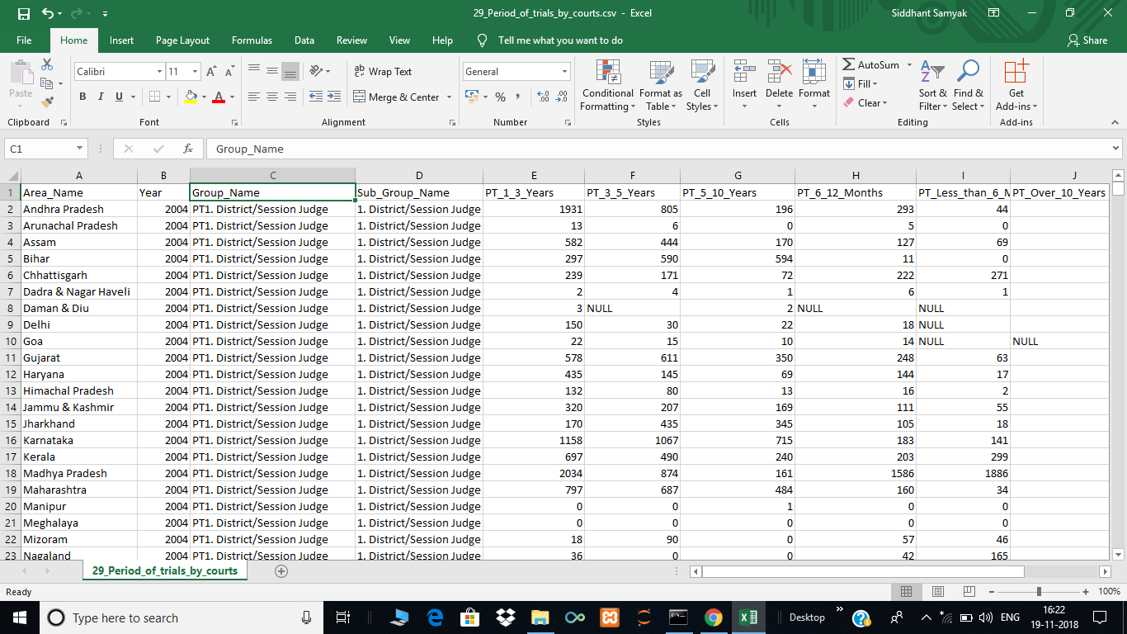

DATA CLEANING
UNCLEANED DATA
CLEANED DATA
CODE SNIPPET: df=pd.read_csv("29_Period_of_trials_by_courts.csv")
Dff=df.fillna(0)
dff.head()

Slide 4
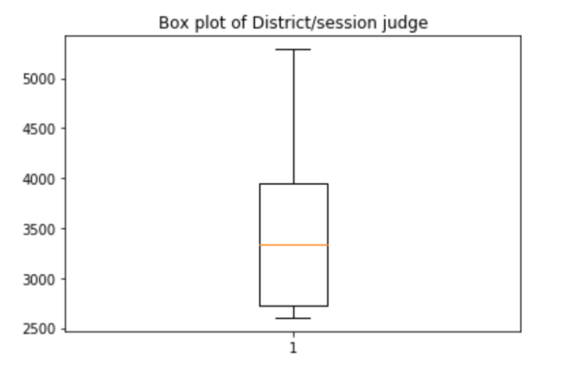
BOXPLOT OF DISTRICT/SESSION JUDGE
From the adjacent boxplot, we can infer that the data is normally distributed because it does not contain any outliers.

Slide 5
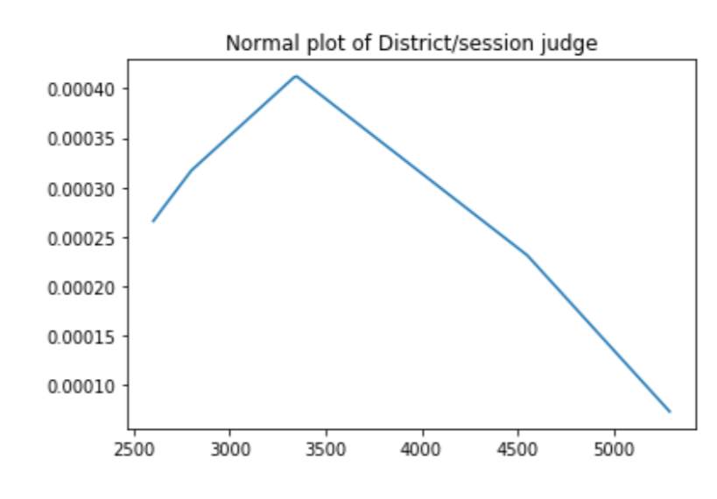
NORMAL PLOT OF DISTRICT/SESSION JUDGE
On plotting a normal probability plot of the previous values, we can see that the data is normally distributed. However, the values on the left are less varied than the values on the right.

Slide 6
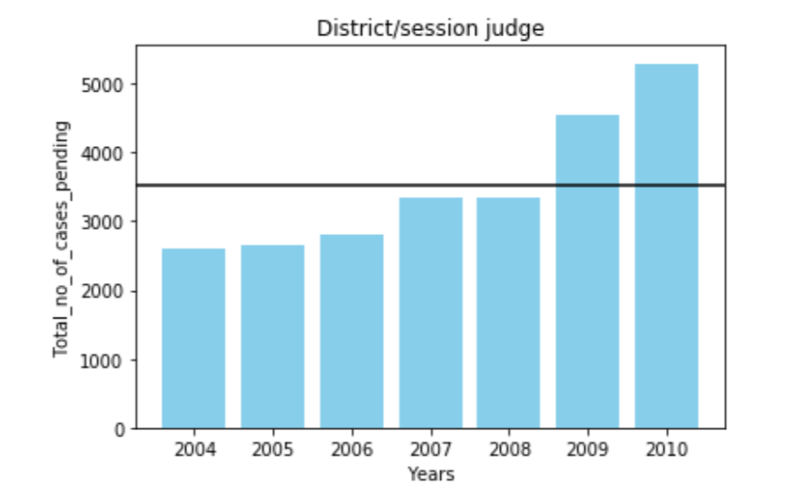
BAR GRAPH ILLUSTRATION
The adjacent bar graph indicates that the number of pending cases per year for the district/session judge has increased gradually over a period of time. The horizontal line indicates the mean number of pending cases per year. There can be 2 reasons for it:
The district/session jugde was inefficient in handling cases.
The number of cases per year has increased over a period of time.

Slide 7
Hypothesis testing of District/Sessions Judge.
Code Snippet:
meankardis=(np.mean(listtotalkardis))
sdkardis=np.std(listtotalkardis)
zkardis=(meankardis-3511)/(sdkardis) #assuming mean to be 3511
print("P-value of District/Session Judge is",sc.norm.cdf(zkardis)-sc.norm.cdf(-1*zkardis))
Based on our dataset, we chose the mean number of total cases pending per year for a District/Sessions Judge to be 3511. Assuming this null hypothesis to be true and carrying out a two tailed test, we achieved a ‘P’ value of:
0.00071.

Slide 8
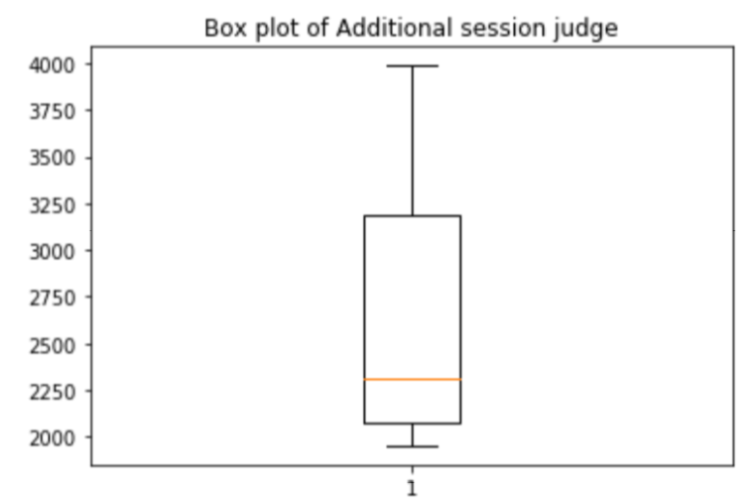
BOXPLOT OF ADDITIONAL SESSION JUDGE
From the adjacent boxplot, we can infer that the data is normally distributed because it does not contain any outliers. The long upper whisker in the example means that values are varied amongst the most positive quartile group, and very similar for the least positive quartile group.

Slide 9
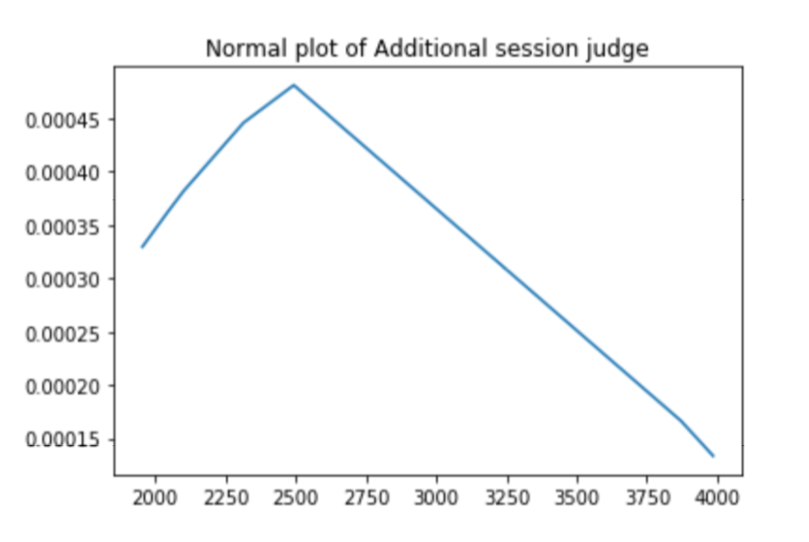
NORMAL PLOT OF ADDITIONAL SESSION JUDGE
On plotting a normal probability plot of the previous values, we can see that the data is normally distributed. However, the values on the left are less varied than the values on the right.

Slide 10
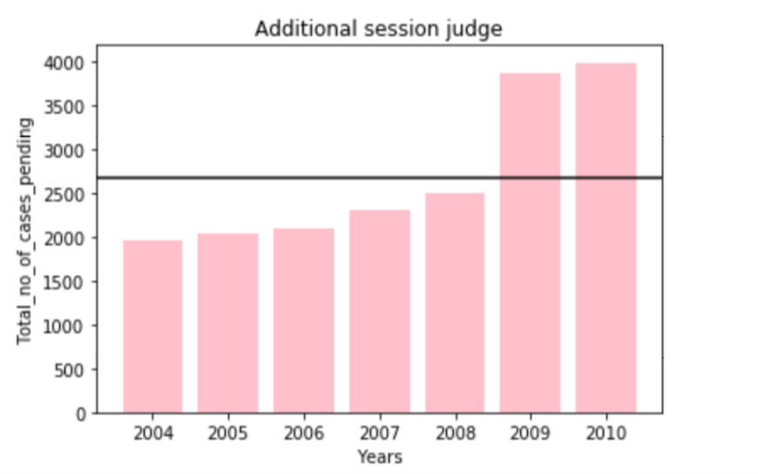
BAR GRAPH ILLUSTRATION
The adjacent bar graph indicates that the number of pending cases per year for the district/session judge has increased gradually over a period of time. The horizontal line indicates the mean number of pending cases per year. The number of pending cases have suddenly increased in the years 2009 and 2010.

Slide 11
Hypothesis testing of Additional Sessions Judge.
meankaradd=(np.mean(listtotalkaradd))
sdkaradd=np.std(listtotalkaradd)
zkaradd=(meankaradd-2680)/(sdkaradd) #assuming mean to be 2680
print("P-value of additional session judge is",sc.norm.cdf(zkaradd)-sc.norm.cdf(-1*zkaradd))
Based on our dataset, we chose the mean number of total cases pending per year for a Additional Sessions Judge to be 2680. Assuming this null hypothesis to be true and carrying out a two tailed test, we achieved a ‘P’ value of:
0.00056

Slide 12
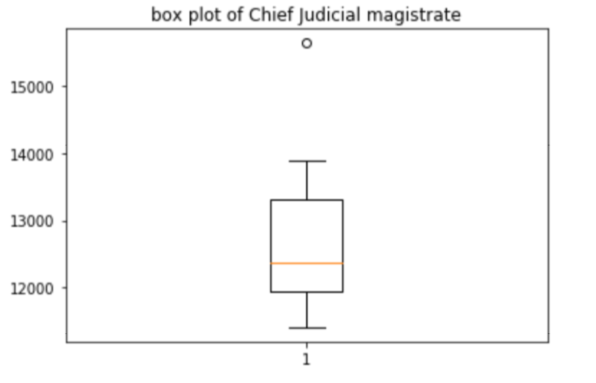
BOX PLOT OF CHIEF JUDICIAL MAGISTRATE
From the adjacent boxplot, we can infer that the data is not normally distributed because it contains any outliers.

Slide 13
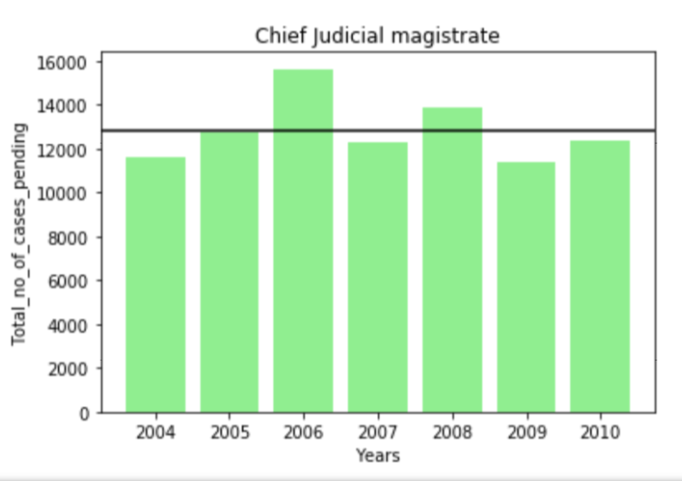
BAR GRAPH OF CHIEF JUDICIAL MAGISTRATE
From the adjacent graph we can see that the pending number of cases have more or less been same every year but a clear outlier is visible in the year 2006 compared to other. Also, the appeals every year to the Chief Judicial Magistrate have been relatively higher.

Slide 14
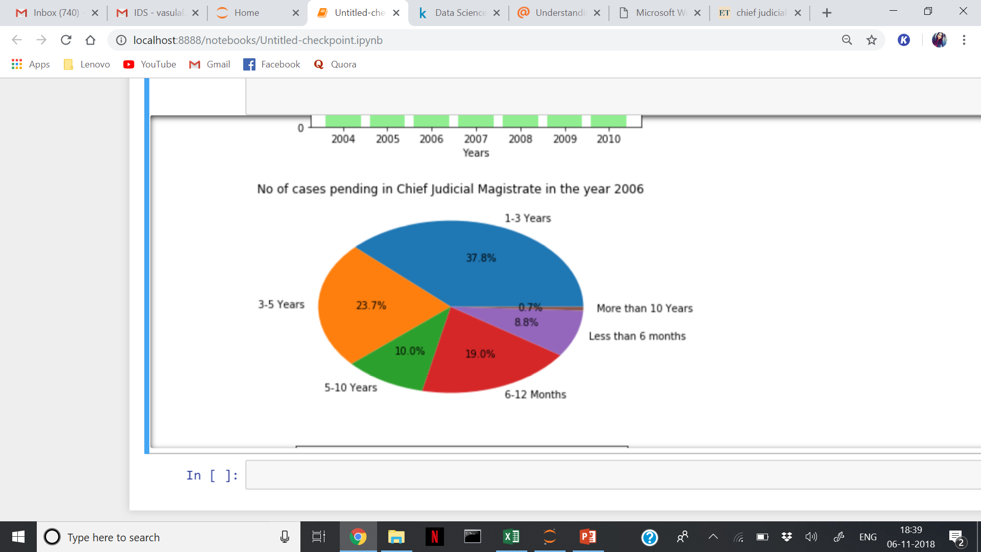
PIE CHART ILLUSTRATION OF CHIEF JUDICIAL MAGISTRATE IN YEAR 2006
Since the number of cases pending in Chief Judicial Magistrate in the year 2006 contains outliers, the adjoining pie chart has been plotted to illustrate the contributions of varying spans of years. The maximun number of pending cases have been observed in the recent 5 years.

Slide 15
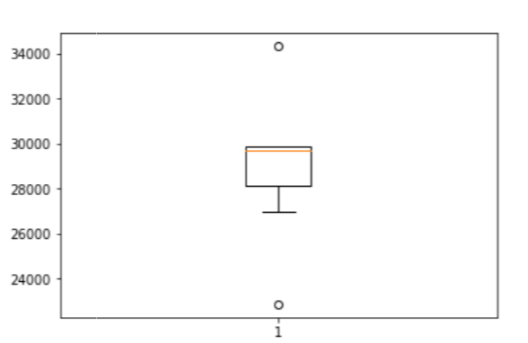
BOX PLOT OF JUDICIAL MAGISTRATE 1
From the adjacent boxplot, we can infer that the data is not normally distributed because it contains two outliers. Also, the data is right skewed.

Slide 16
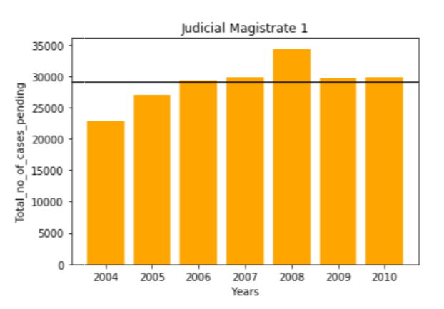
BAR GRAPH OF JUDICIAL MAGISTRATE 1
From the adjacent graph we can see that the pending number of cases have more or less been same every year but a clear outlier is visible in the year 2008 compared to other. Also, the appeals every year to the Judicial Magistrate 1 have been relatively higher.

Slide 17
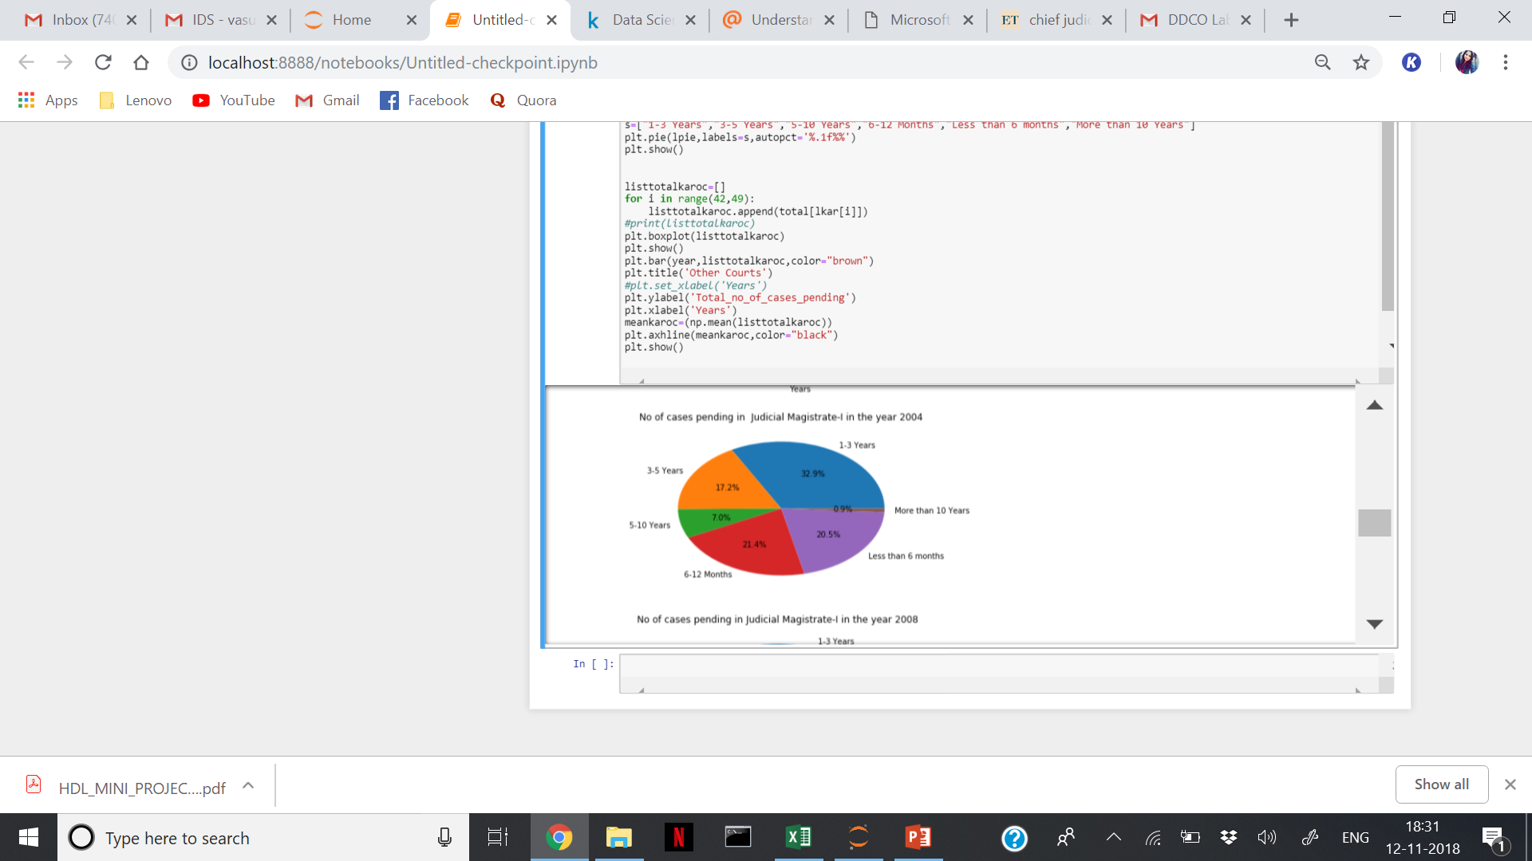
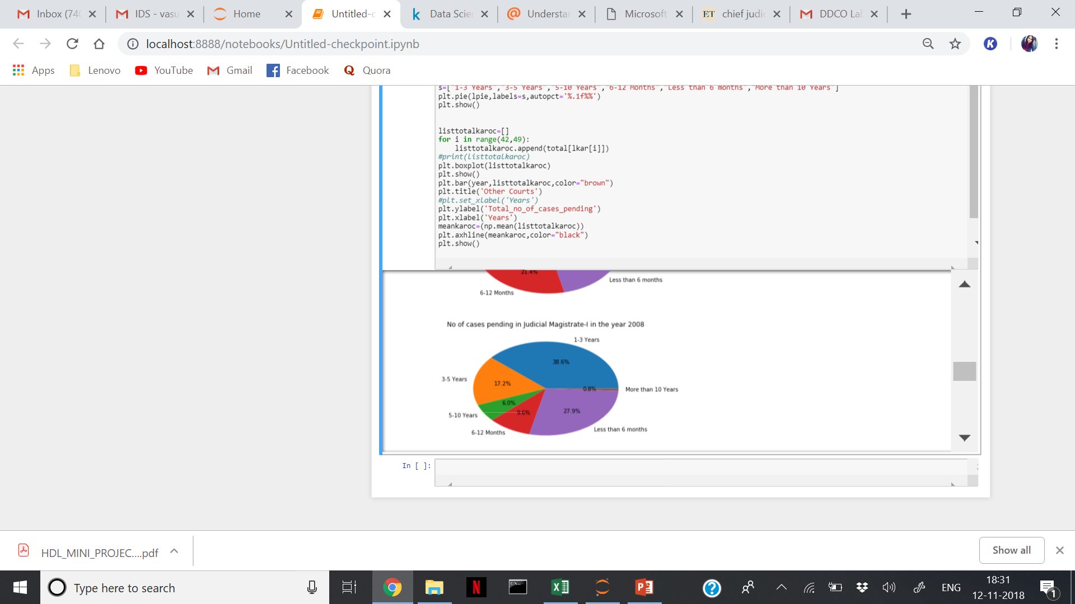
PIE CHART ILLUSTRATION OF JUDICIAL MAGISTRATE 1 IN YEAR 2004 and 2008
From the pie chart, it is clear that the number of pending cases in the recent 3 years have increased from 33% to 36.5% whereas other spans of years have fairly remained constant.

Slide 18
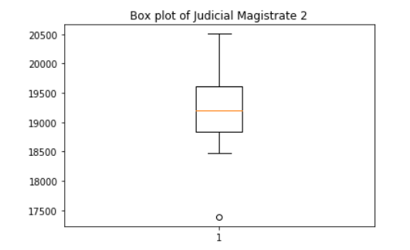
BOX PLOT ILLUSTARTION OF JUDICIAL MAGISTRATE 2
From the adjacent boxplot, we can infer that the data is not normally distributed because it contains an outlier. Also, the data is left skewed.

Slide 19
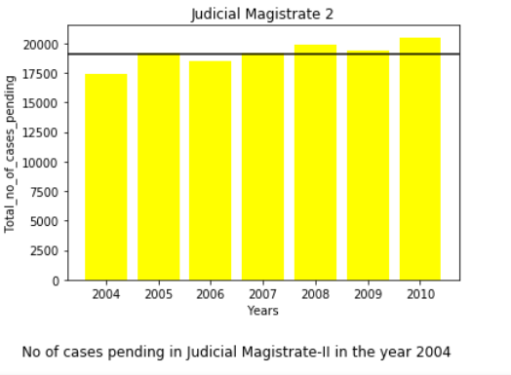
BAR GRAPH ILLUSTRATION OF JUDICIAL MAGISTRATE 2
From the adjacent graph, we can infer that the number of pending cases per year have not shown any significant change over the years. The values for each year are fairly close except in 2004 in which it is slightly less. Thus, we can conclude that the Judicial Magistrate 2 has worked with the same high efficiency every year.

Slide 20
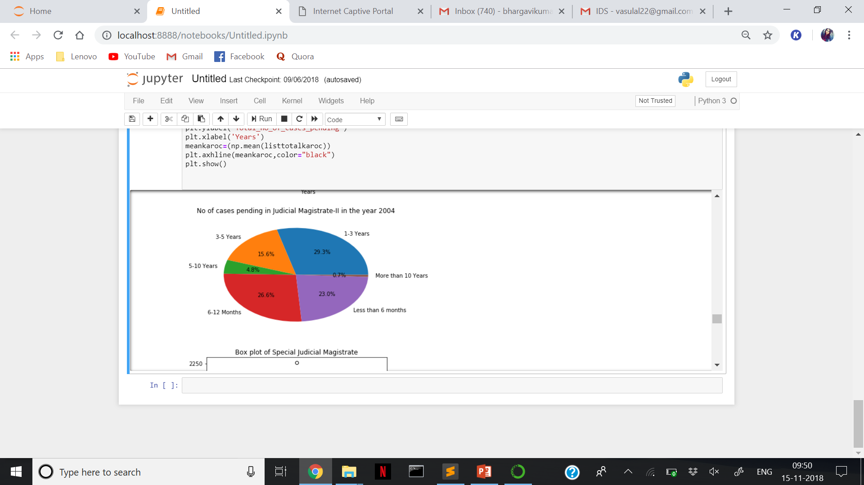
PIE CHART ILLUSTRATION OF JUDUCIAL MAGISTRATE 2 IN 2004
Since the number of pending cases per year for Judicial Magistrate 2 in the year 2004 contains outliers, the adjoining pie chart has been plotted to illustrate the contributions of the varying spans of years. The maximum number of pending cases have been observed in the recent 6-12 months.

Slide 21

BOX PLOT ILLUSTRATION OF SPECIAL JUDICIAL MAGISTRATE
The adjacent box plot illustrates that the data is not normally distributed as it contains an outlier.

Slide 22
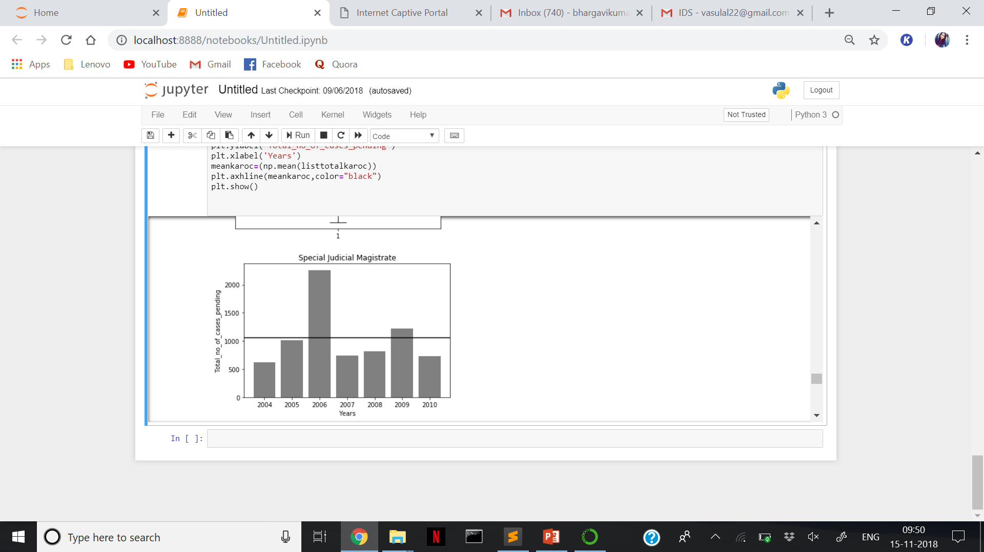
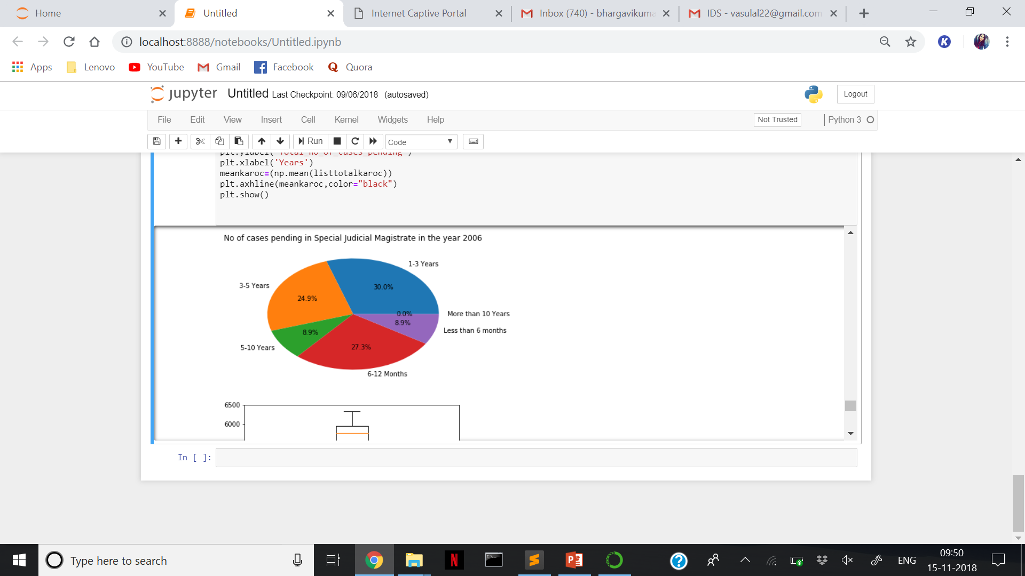
BAR GRAPH AND PIE CHART ILLUSTRATION OF SPECIAL JUDICIAL MAGISTRATE
From the adjacent graph, we can infer that there is a clear outlier in the year 2006 because the total number of pending cases is significantly higher as compared to the other years. This rise could be attributed to
the fall of the Congress-led government through a political coup leading to a new Janata Dal (Secular)-Bharatiya Janata Party coalition,
arrest of two Pakistani militants
the row set off by bribery allegation against Chief Minister H D Kumaraswamy.
2 militants of Pakistan-based terrorist outfit Al-Badr.
7 Lashkar-e-Tayiba militants were arrested in connection with a shootout at IISC Bengaluru.
Owing to the aforementioned factors, the number of legal cases under the Special Judicial Magistrate may have increased which explains the rise in the number of pending cases in the year 2006.

Slide 23

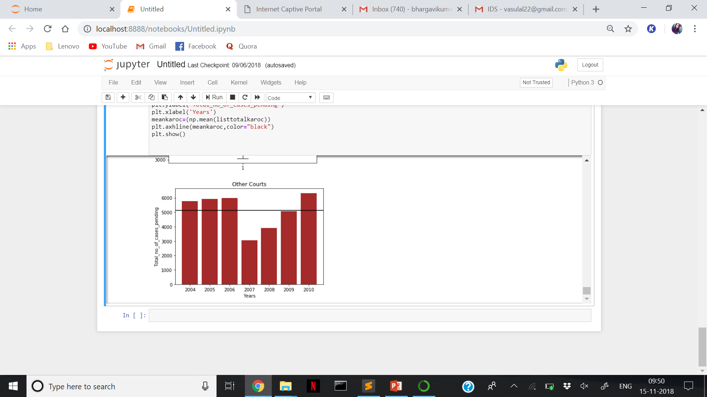
BOX PLOT AND BAR GRAPH ILLUSTRATIONS OF OTHER COURTS
The adjacent graph indicates that the number of pending cases per year in other courts is not normally distributed and is right skewed. It contains clear outliers in the year 2007 and 2008.

Slide 24
THANK YOU!
Siddhant Samwayak
Vikash Agarwal
Satyam Lal
COMPILED BY:

